Slide 1

MUSYA
University Library System
A Python program for books, members, and borrowing records
Team
Kuanysh Asker · Zhan Sharkhanov · Zhanibek Uzakbai
October 2026

Slide 2




What the program stores
Python + SQLite · We made a small library program to add and manage books, members, and loans.
Books
Borrowings
Members
book_id
title
author
genre
available
borrowing_id
book_id
member_id
returned
member_id
name
email
study program
Borrowings connect a member with a book.
Current sample database
The Book and Member classes format records for display. Email input is checked with a regular expression, and random is used for sample borrowing data.
50
40
30
books
members
borrowings

Slide 3
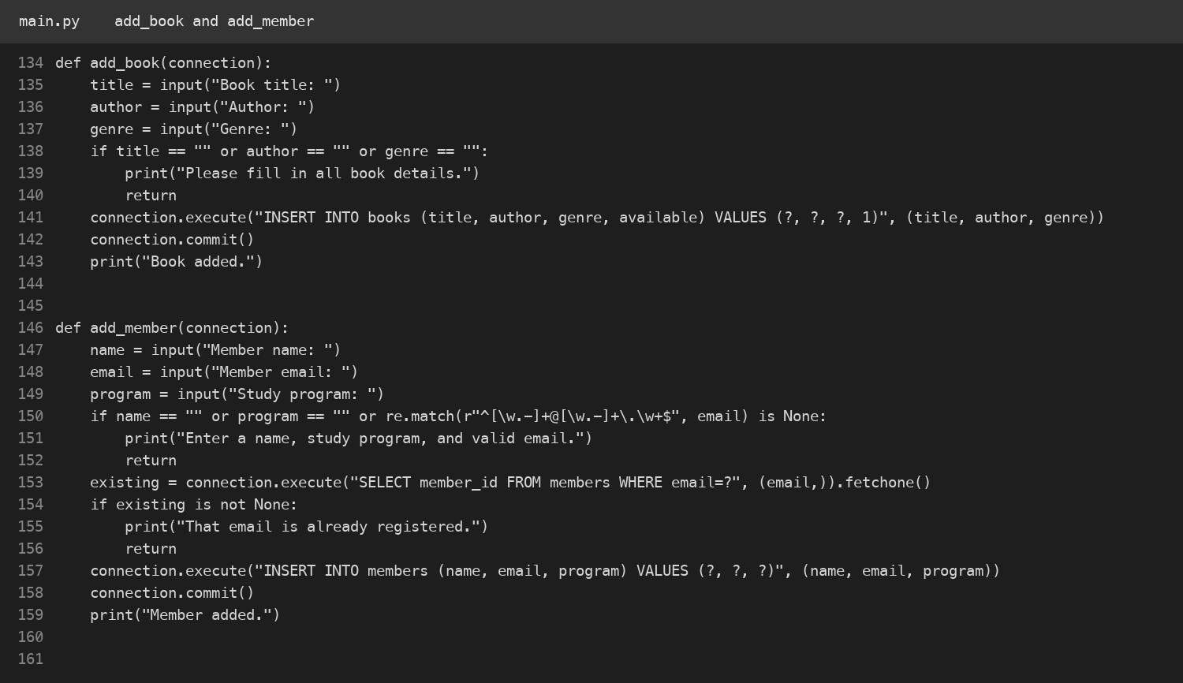
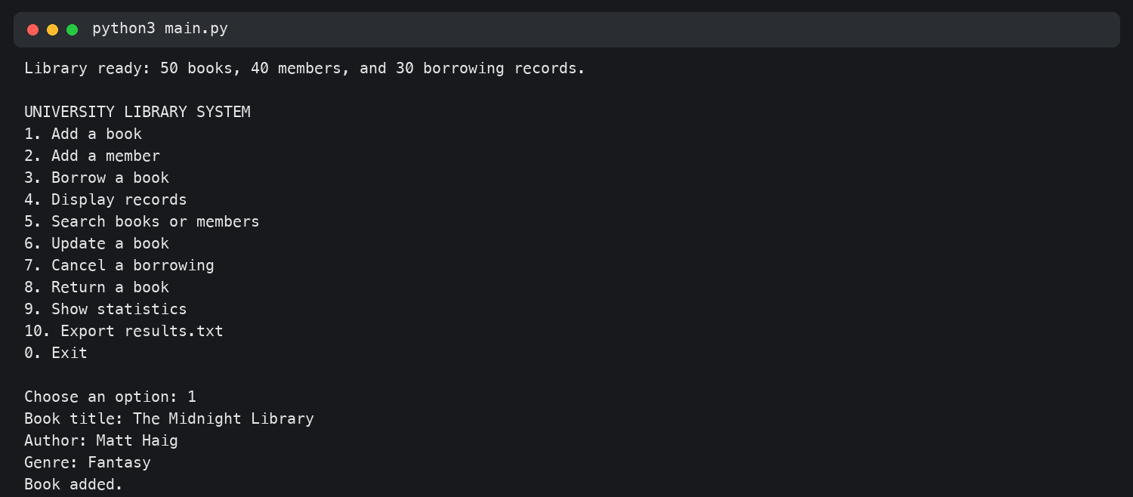
Adding records
Kuanysh Asker · Task 1
The terminal shows a book added successfully.
The functions ask for book or member details, check required fields, then save to SQLite.

Slide 4
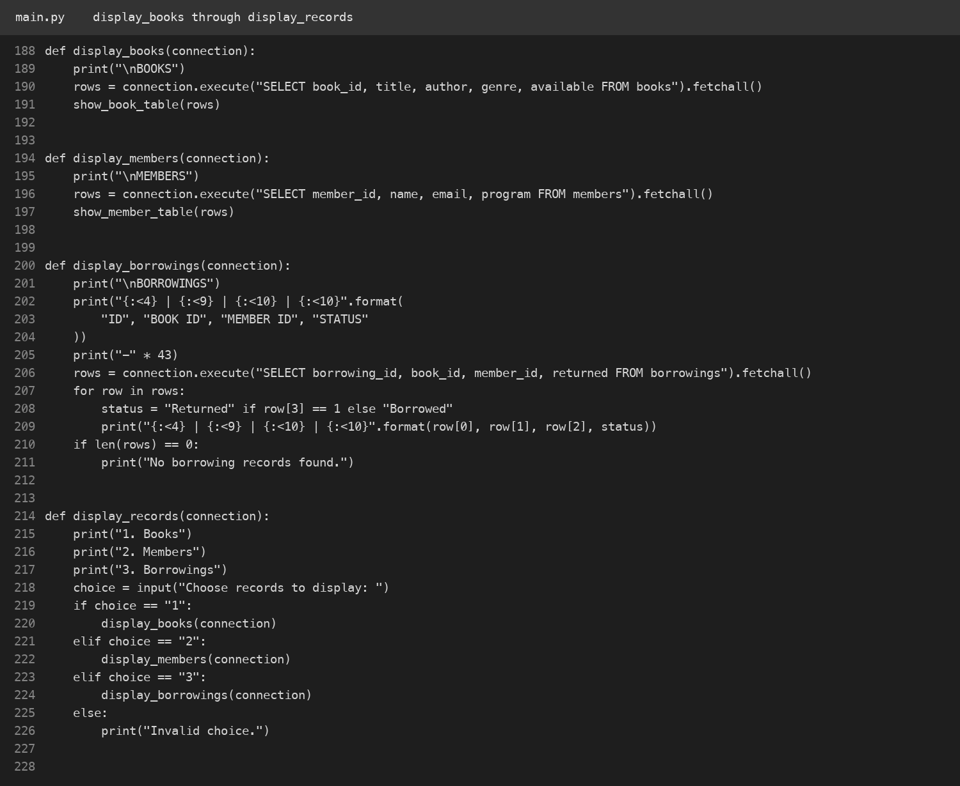
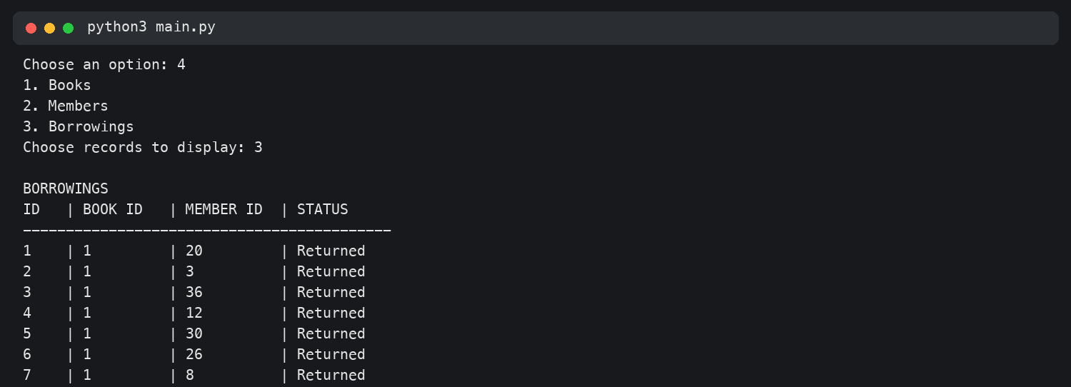
Displaying records
Kuanysh Asker · Task 2
Example output: borrowing ID, book ID, member ID, and status.
The menu lets the user choose books, members, or borrowings. Each option reads saved rows from the database.

Slide 5
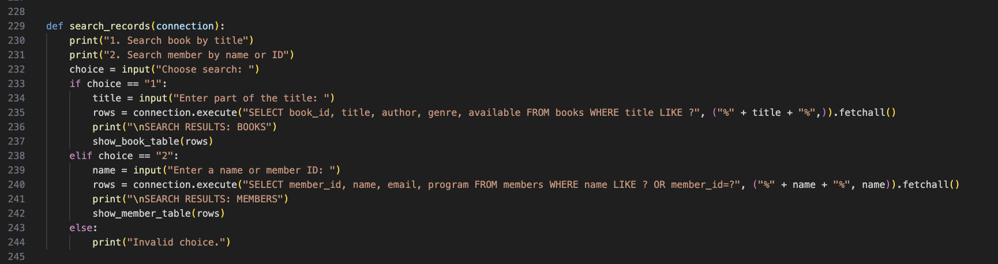
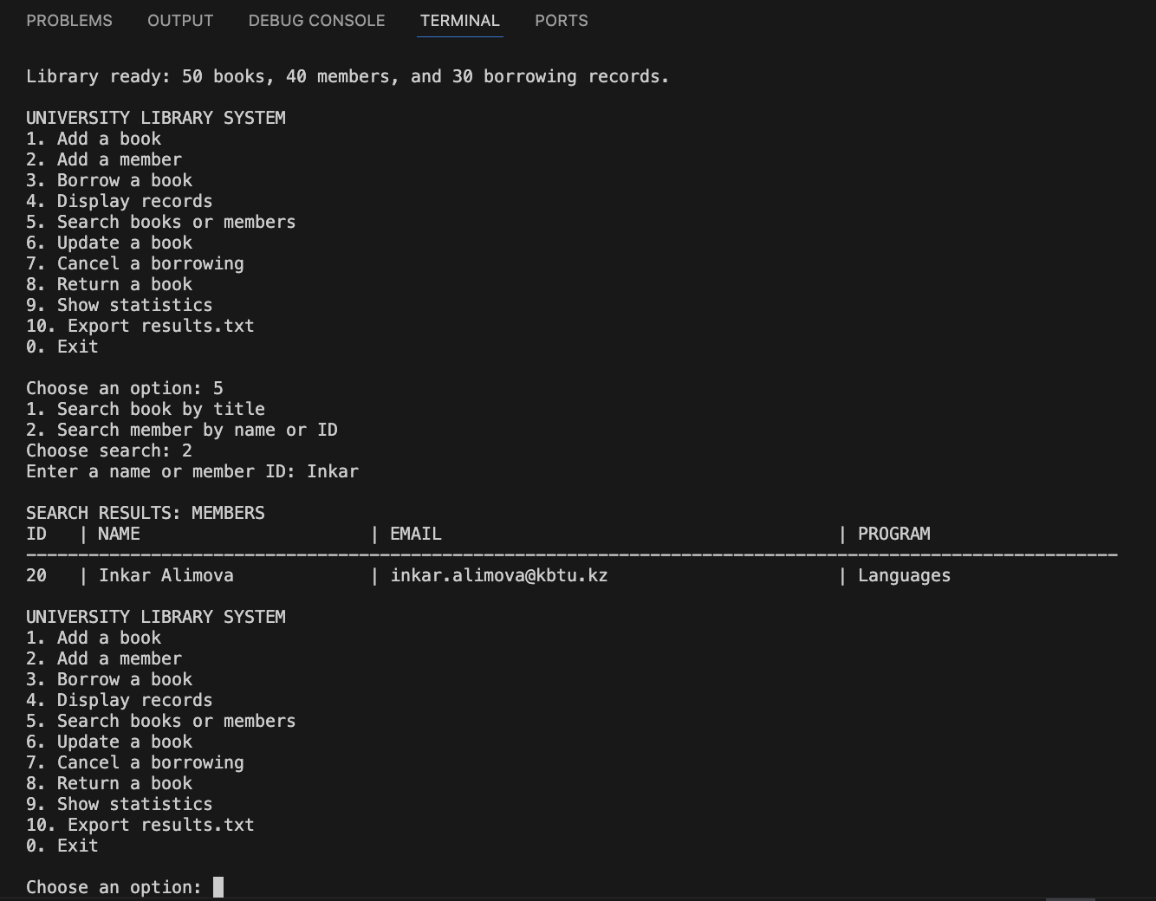
Searching the records
Zhan Sharkhanov · Task 4
Example: “Inkar” finds member ID 20.
Search by part of a book title, or search members by name or ID.

Slide 6
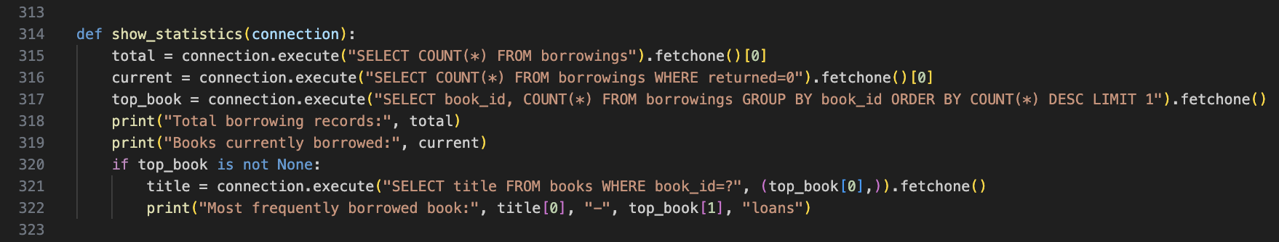
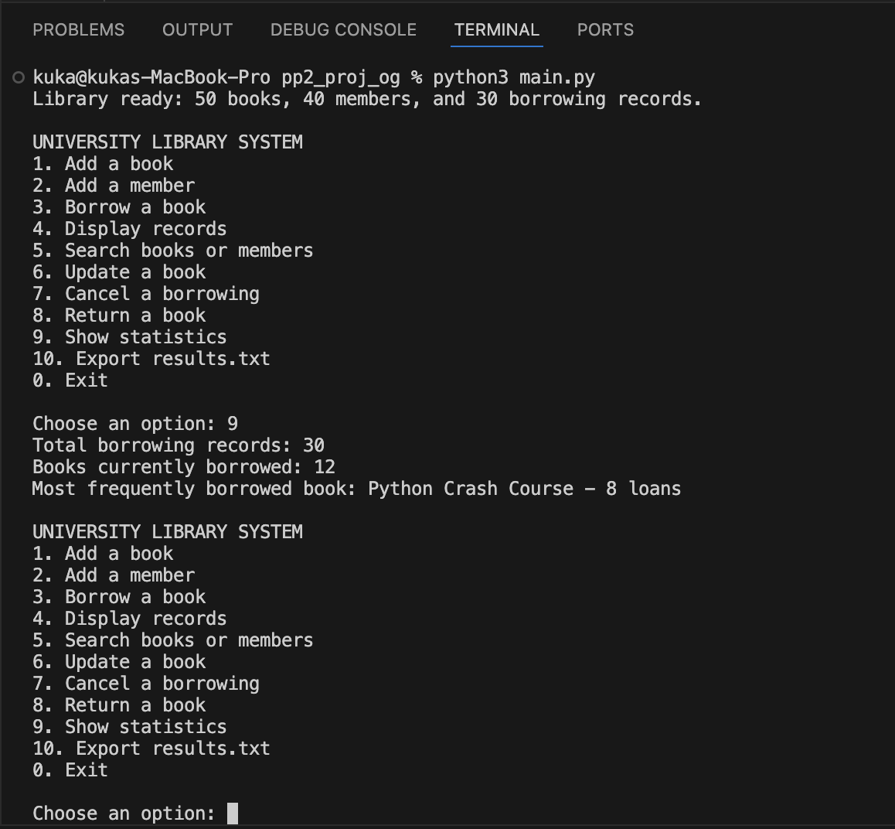
Statistics from the database
Zhan Sharkhanov · Task 3
30
12
8
total borrowings
current loans
loans of Python Crash Course
The program counts all borrowing records and current loans, then finds the most borrowed title.

Slide 7
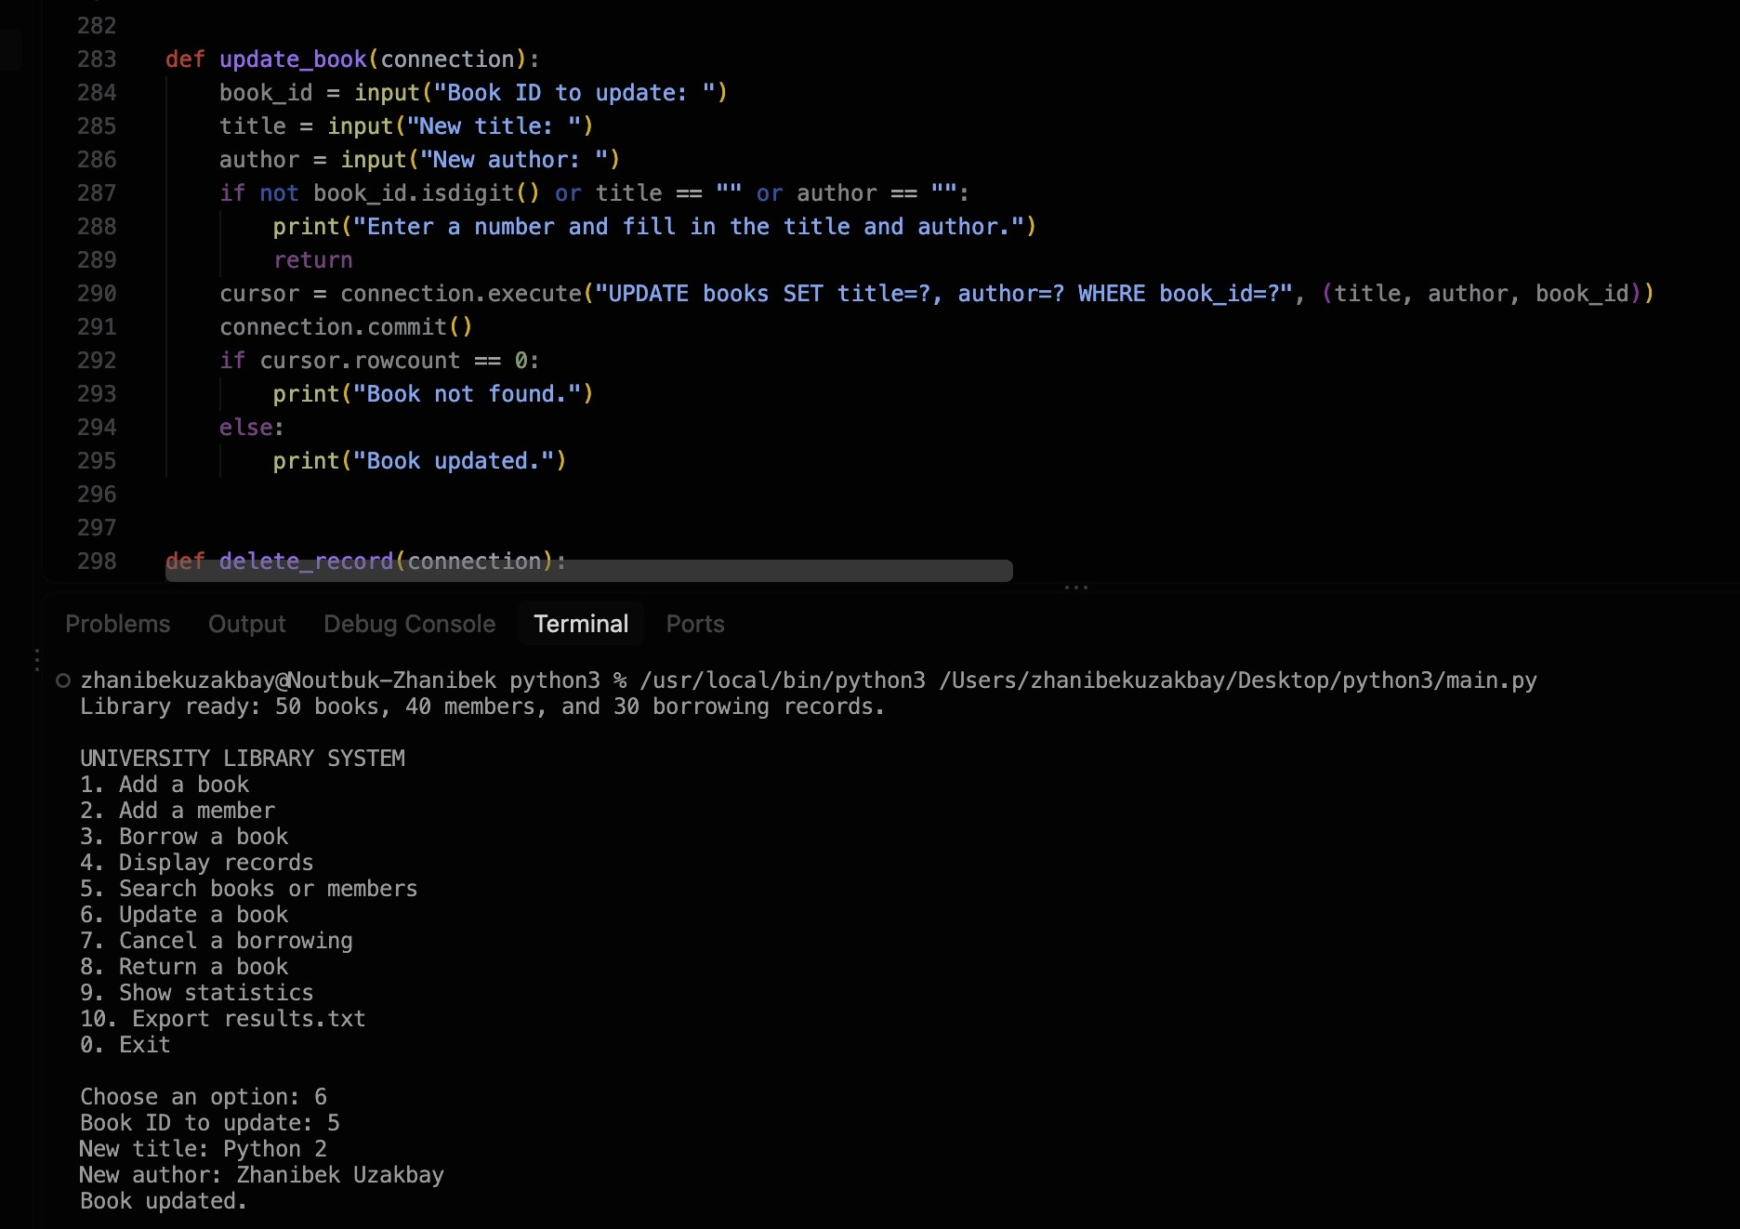
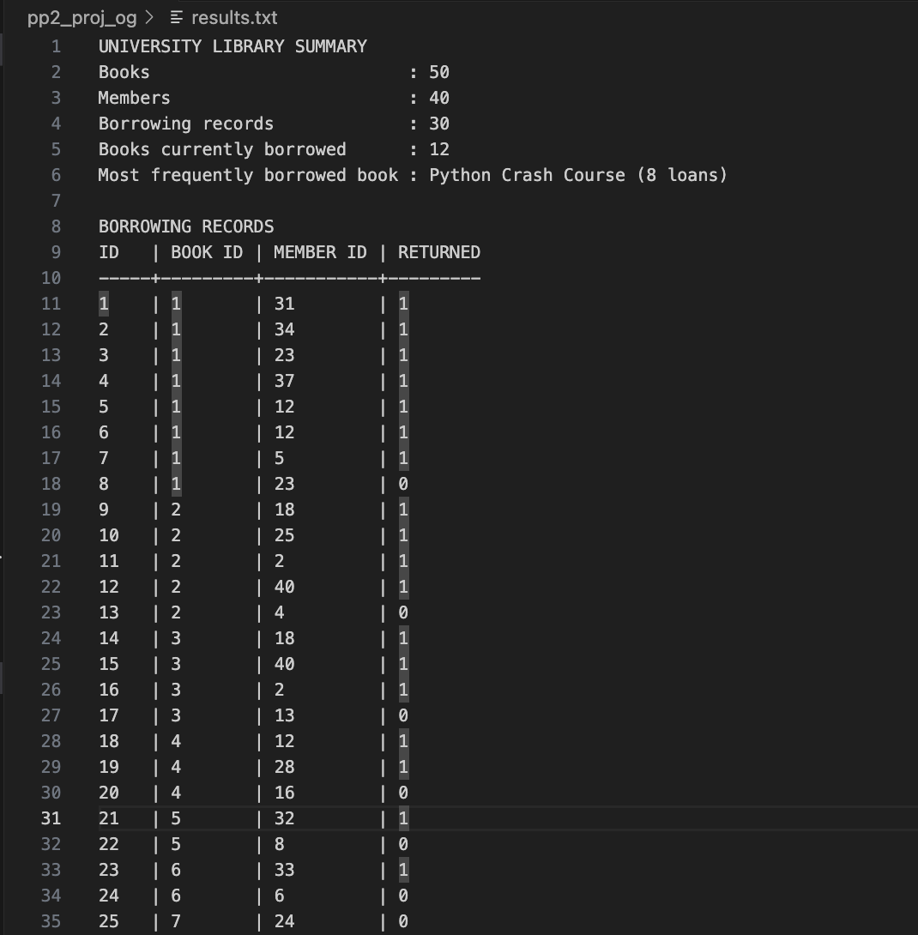
Updating and exporting
Zhanibek Uzakbai · Tasks 5–6
Latest export summary and borrowing list
He added functions to update a book, cancel or return a borrowing, and export results.txt.
The current export shows 50 books, 40 members, 30 borrowing records, 12 active loans, and Python Crash Course as the most borrowed book.

Slide 8


